Slide 1
AXI protocol
Advanced eXtensible Interface

Slide 2
What is AMBA
AMBA = Advanced Microcontroller Bus Architecture
It is a standard on-chip communication protocol
Used to connect CPU, memory, and peripherals inside a SoC
Defined by ARM
Helps in IP(Intellectual Property block) reuse and interoperability(Hardware blocks made by different companies still work together.)
Supports high-speed and low-speed data transfers
Common AMBA buses: AXI, AHB, APB

Slide 3
AMBA family
AMBA mainly have 3 major protocols
Feature | APB | AHB | AXI
Performance | Low | Medium–High | Very High
Channels | Single | Single | 5 Independent Channels
Architecture | Simple, Register-based | Shared Bus | Interconnect / Switch
Latency | High | Low | Lowest
Power | Lowest | Medium | Highest
Use Case | Peripherals (UART, I2C) | Memory, Fast Peripherals | Main System / CPU / DSP

Slide 4
Why axi protocol?
High Bandwidth AXI supports burst transfers (AWLEN/ARLEN) and wide data paths, allowing large amounts of data to move efficiently—critical for high-performance CPUs, GPUs, and DSPs.
Low Latency Separate address, data, and response phases reduce wait states, enabling faster access to memory and peripherals.
Independent Read & Write Channels Read and write operations occur in parallel, eliminating contention and significantly boosting data transfer performance.

Slide 5
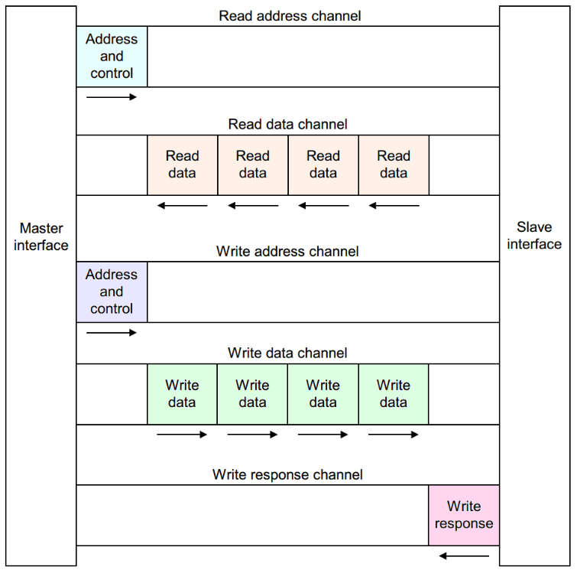
AXI Architecture Overview

Slide 6
AXI Channel Structure
Five Independent Channels & Their Directions • Write Address Channel (AW) — Master → Slave: carries write address and control information. • Write Data Channel (W) — Master → Slave: carries the actual write data. • Write Response Channel (B) — Slave → Master: returns status of write completion. • Read Address Channel (AR) — Master → Slave: carries read address and control information. • Read Data Channel (R) — Slave → Master: returns read data along with read response.
Purpose of Each Channel • AW: Define where and how data should be written. • W: Transfer the payload data for write transactions. • B: Acknowledge write completion (OKAY/SLVERR/DECERR). • AR: Request read from a specific address. • R: Return the requested read data + status.

Slide 7
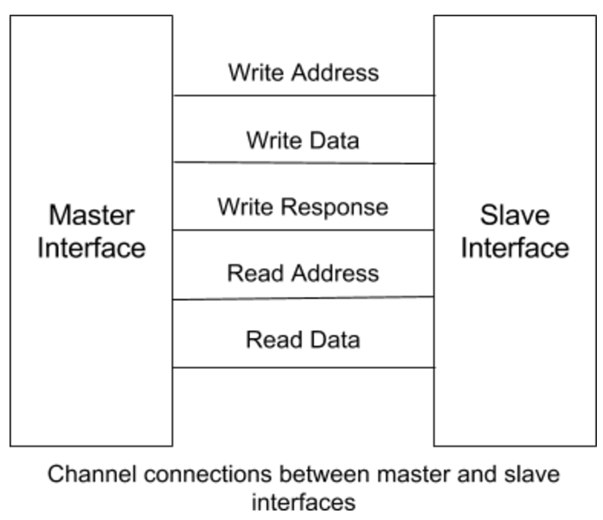

Slide 8
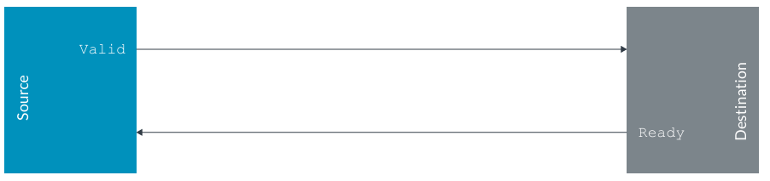
AXI VALID–READY Handshake Mechanism
Definition of VALID • The source (sender) asserts VALID to indicate that the address, data, or control information on the channel is valid and can be transferred. • Once asserted, VALID must remain high until the transfer completes.
Definition of READY • The destination (receiver) asserts READY to indicate that it can accept the information on that channel. • READY may toggle until a handshake occurs.
Transfer Condition • A transfer occurs only when both VALID && READY are high on the same rising clock edge. • This synchronous handshake ensures reliable data/control transfers on all AXI channels.

Slide 9
AXI Write Transaction Flow
1. Write Address Phase
• The AXI master initiates a write transaction by placing the write address and control information on the Write Address Channel (AW). • The master asserts AWVALID to indicate that the address and control signals are valid. • The slave asserts AWREADY when it is ready to accept the write address. • The address phase completes when AWVALID && AWREADY are high on a rising clock edge.
2. Write Data Phase
• After or independent of the address phase, the master transfers write data on the Write Data Channel (W). • The master asserts WVALID when write data is available. • The slave asserts WREADY when it can accept the data. • Each data beat transfers when WVALID && WREADY are high.

Slide 10
3. Write Data Burst Completion
• For burst writes, multiple data beats are sent on the W channel. • The master asserts WLAST during the final data beat of the burst. • WLAST indicates the end of the write data transfer for that transaction.
4. Write Response Phase
• After receiving the final data beat, the slave returns a response on the Write Response Channel (B). • The slave asserts BVALID to indicate the response is valid. • The master asserts BREADY when it is ready to accept the response. • The write transaction completes when BVALID && BREADY are high.

Slide 11
AXI Read Transaction Flow
1. Address Phase
• The AXI master initiates a read by placing the read address and control information on the Read Address Channel (AR). • The master asserts ARVALID to indicate that the address and control signals are valid. • The slave asserts ARREADY when it is ready to accept the read request. • The address transfer completes when ARVALID && ARREADY are high on a rising clock edge.
2. Data Phase
• After accepting the address, the slave returns read data on the Read Data Channel (R). • The slave asserts RVALID when read data is available. • The master asserts RREADY when it is ready to accept the data. • Data transfer occurs when RVALID && RREADY are high.

Slide 12
3. Role of Key Signals
• ARVALID — Indicates that the read address and control information are valid. • ARREADY — Indicates that the slave can accept the read address. • RVALID — Indicates that the slave is providing valid read data. • RREADY — Indicates that the master is ready to receive read data. • RLAST — Asserted by the slave to indicate the final beat of a read burst.

Slide 13
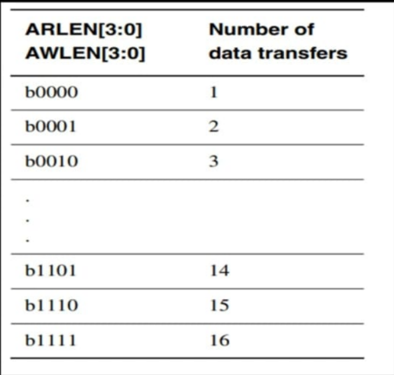
AXI Burst Transactions
• A burst transaction allows multiple data transfers to occur for one address phase. Bursts improve bus efficiency and throughput by reducing address overhead.
Burst Length (LEN)
LEN specifies the number of data beats in a burst. • Actual number of transfers = LEN + 1. • Example: LEN = 3 → 4 data beats.

Slide 14
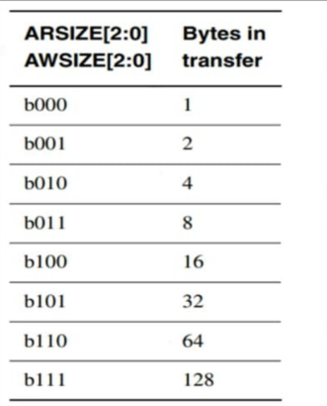
Burst Size (SIZE) – AXI Protocol
SIZE specifies the number of bytes transferred per beat in an AXI burst.
The value of SIZE determines data width per transfer.
All beats in a burst use the same SIZE value.
Address increments by bytes per beat for each beat.
Example: SIZE = 2 → 2² = 4 bytes per beat

Slide 15
Burst Types
AXI supports three burst types:
1. FIXED Burst
• Address remains constant for every data beat. • Commonly used for FIFO or peripheral registers.
2. INCR Burst
• Address increments by the transfer size after each beat. • Most commonly used burst type for memory accesses.
3. WRAP Burst
• Address increments, but wraps around when it reaches a boundary. • Used for cache-line aligned transfers.

Slide 16
BURST CALCULATIONS FOR FIXED
Number of Beats Number of beats = LEN + 1 Example: AWLEN = 3 → 4 beats
Bytes per Beat Bytes per beat = 2^SIZE Example: AWSIZE = 2 → 2² = 4 bytes
Address Calculation (FIXED Burst)
Address for every beat = Same start address
Example: Start Address = 0x1000 Beat 1 → 0x1000 Beat 2 → 0x1000 Beat 3 → 0x1000 Beat 4 → 0x1000
Key Point for FIXED Burst Address does not increment Data transfers occur repeatedly at the same address Total transfer size = (LEN + 1) × (2^SIZE)

Slide 17
BURST CALCULATIONS FOR INCR
Number of Beats Number of beats = LEN + 1 Example: AWLEN = 3 → 4 beats
Bytes per Beat Bytes per beat = 2^SIZE Example: AWSIZE = 2 → 2² = 4 bytes
Address Calculation (INCR Burst)
Address for next beat = Previous address + (2^SIZE)
Example: Start Address = 0x1000 AWSIZE = 2 → 4 bytes per beat
Beat 1 → 0x1000 Beat 2 → 0x1004 Beat 3 → 0x1008 Beat 4 → 0x100C
Total Transfer Size
Total bytes = (LEN + 1) × (2^SIZE)
Example: AWLEN = 3, AWSIZE = 2 Total = 4 × 4 = 16 bytes

Slide 18
BURST Value | Burst Type | Address Behavior | Typical Use
00 | FIXED | Address does not change for each beat | FIFO, peripheral registers
01 | INCR | Address increments by SIZE each beat | Sequential memory access
10 | WRAP | Address increments and wraps at boundary | Cache line transfers
11 | Reserved | Not used | —

Slide 19
VALID–READY Handshake Mechanism
Definition of VALID
• VALID is asserted by the SOURCE (master or slave) to indicate that the address, data, or control information on the channel is valid. Once asserted, VALID must remain high until a successful transfer occurs.
Definition of READY
• READY is asserted by the DESTINATION to indicate that it is ready to accept the transfer. READY can be asserted or deasserted at any time to control data flow.

Slide 20
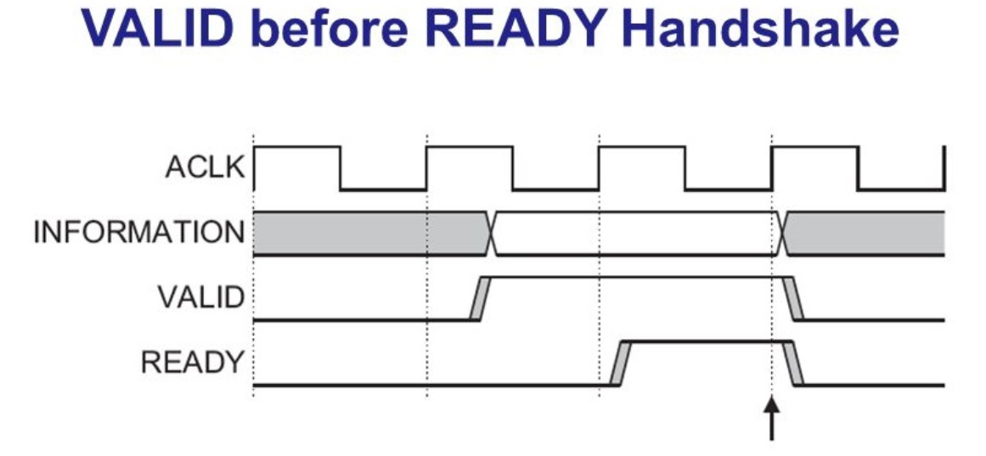
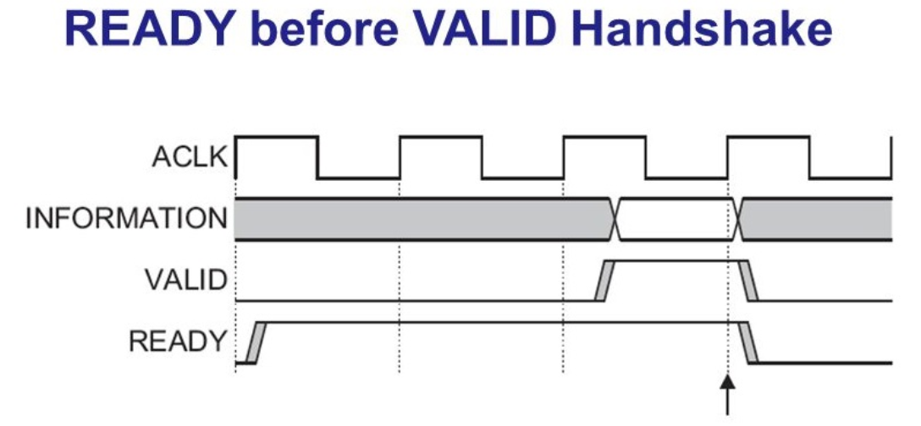

Slide 21
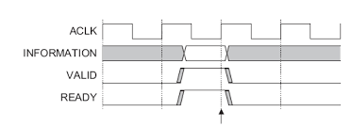
READY WITH VALID HANDSHAKE

Slide 22
Clock and Reset Behavior
Single Global Clock (ACLK)
• All AXI signals are sampled and driven synchronously on the rising edge of ACLK. • Every AXI channel (read, write, response) operates in the same clock domain. • A single clock simplifies timing analysis and avoids intra-protocol CDC issues.
Active-Low Reset (ARESETn)
• ARESETn is an active-low reset signal for the AXI interface. • When ARESETn = 0, the AXI interface is reset to a known idle state. • During reset:
VALID signals must be deasserted
No transactions are allowed

Slide 23
Advantages of AXI (Advanced eXtensible Interface)
High performance (supports high bandwidth)
Separate read and write channels → parallel transfers
Burst transfers improve efficiency
High clock frequency support
Scalable (works for small to very complex SoCs)
Low latency for high-speed systems

Slide 24
Disadvantages of AXI
Complex protocol (many signals, harder to design/debug)
Large hardware overhead
Consumes more power compared to simpler buses
Not suitable for simple peripherals
Verification is more difficult
Interconnection design is complex

Slide 25
Thank you

